Slide 1
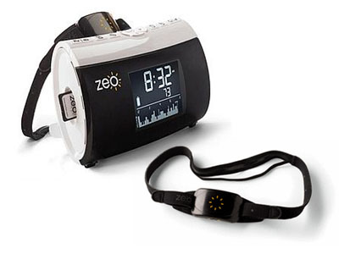
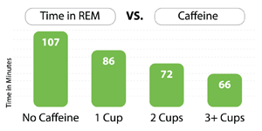
Zeo Personal Sleep Manager
Price: $129
Monitors brain wave patterns
Discovers factors that can be affecting sleep
SmartWake Alarm System
Will wake you up when your out of deep sleep.
No annoying alarms
Analyze and improve sleep using online tools
Detailed graphs/charts
www.myzeo.com

Slide 2
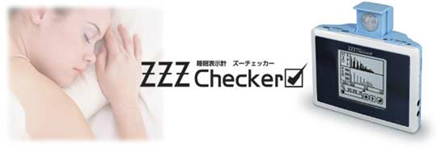
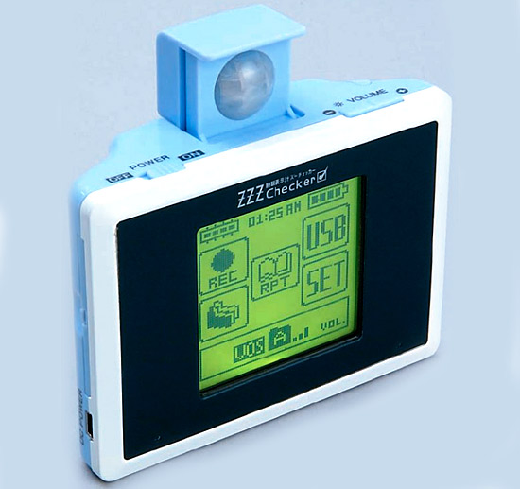
ZZZ Checker Sleep Cycle Monitor
Price: $294
Equipped with a microphone and infrared sensors
to monitor snoring, teeth grinding and visual data
Compiles sleep patterns into understandable graphs
No Electrodes or Headbands required
Sensor Coverage: 120 degrees, 4m

Slide 3
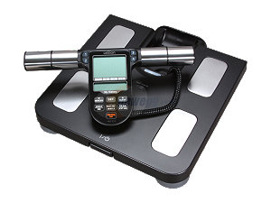
Full Body Sensor Body Composition Monitor and Scale
(HBF-516B)
Price: $71.49 (www.newegg.com)
Measures 7 fitness Indicators
Body Fat %
Body Mass Index
Skeletal Muscle
Resting Metabolism
Visceral Fat (fat surrounding internal organs)
Body Age
Body Weight
4-Person Memory Settings

Slide 4
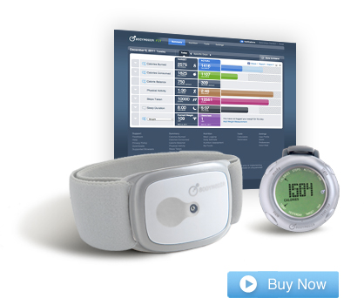
BodyMedia FIT Arm Band
Price Range: $99-$160
Tracking is done with 4 sophisticated sensors
Captures +5000 data points/min
Clinically proven to improve weight loss by 3x
Tracks:
temperature
Sweat
Steps
calories consumed/burned
Sleep quantity, quality
Cons:
In order to begin program, you must subscribe to online Activity Manager
($7/month→12 months)

Slide 5
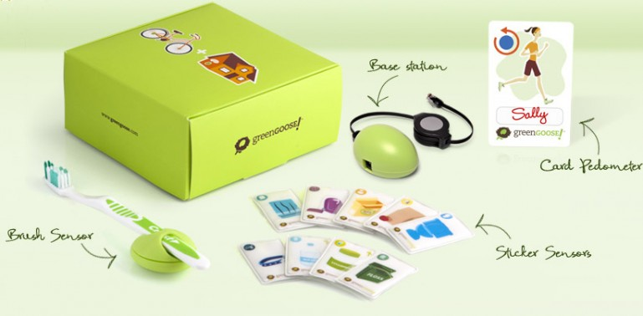
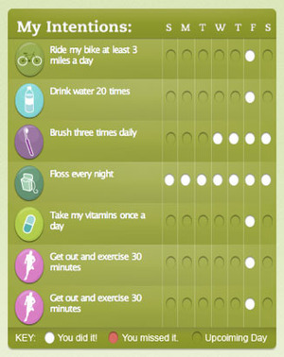
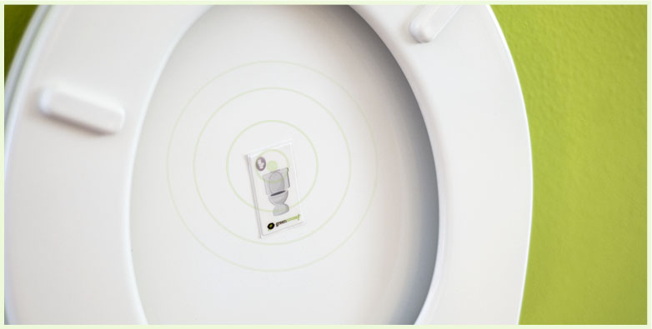
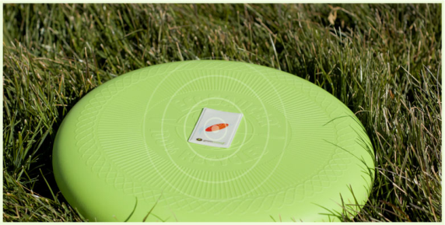
Green Goose Sensors
Starter Kit Price: $49
includes: 3 sensors
Base Station + App
$9 per extra sensor
Sensors powered by battery that lasts a year
Sensor Range: +250 ft.
Based on game/reward system
Over 100 sensors in development!

Slide 6
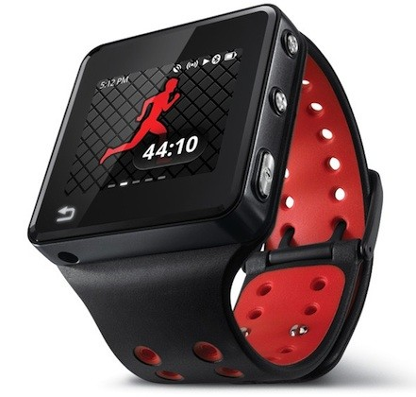
MOTOACTV Fitness Tracker + Smart Music Player
Price: 8GB→$249
16 GB→ $299
Sweatproof, scratch resistant, rain resistant
Track: Distance, time, speed, heart rate,
and calories burned
600MHz processor
Smart Player develops motivational playlist
Touch Screen (1.6-inch)
Capable of receiving software updates for optimal
functionality

